Slide 1






PowerShell Conference Asia
Core, Containers and Performance Graphics

Slide 2

Agenda
Tour of Stats
Common Techniques
Excel
MS Graph
Containers
TICK in my future
PowerShell Conference
Singapore 2017

Slide 3
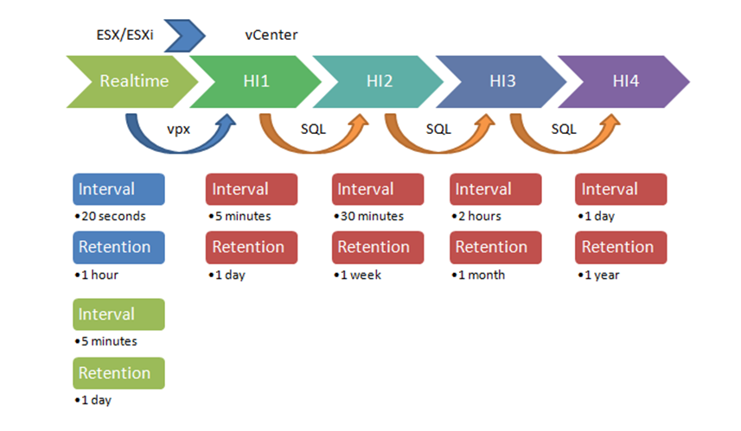
Getting the Data 1
Know what data is available
PowerCLI contains Get-Stat cmdlet
Know how vSphere collects performance data!
PowerShell Conference
Singapore 2017

Slide 4
Getting the Data 2
Realtime contains most info
Go for all metrics
Can produce a lot of data!
Check what is there. Don‘t assume!
PowerShell Conference
Singapore 2017

Slide 5
Getting the Data 3
$fileName = "D:\Stats\Stats-20170927-0008.csv"
$stats = Import-Csv -Path $fileName -UseCulture | Sort-Object -Property TimeStamp
Write-Host "Start : $(([DateTime]$stats[0].Timestamp).ToString('yyyy/MM/dd HH:mm'))"
Write-Host "End : $(([DateTime]$stats[-1].Timestamp).ToString('yyyy/MM/dd HH:mm'))"
Write-Host "Rows : $($stats.Count)"
Write-Host "Metrics : $(($stats | Group-Object -Property MetricId).Count)"
Write-Host "Instance: $(($stats | Group-Object -Property Instance).Count)"
PowerShell Conference
Singapore 2017

Slide 6
Getting the Data 4
Do not forget a metric anymore!
Dump them all (if you have the free disk space)
PowerShell Conference
Singapore 2017

Slide 7
$finish = Get-Date
$start = $finish.AddHours(-1)
$fileName = "D:\Stats\Stats-$($start.ToString('yyyyMMdd-HHmm')).csv"
$entity = @()
$entity += Get-VM -Name stress*
$entity += Get-VMHost -Name esx*
$stat = @()
$stat += Get-StatType -Entity $vm -Start $start
$stat += Get-StatType -Entity $esx -Start $start
$stats = Get-Stat -Entity $entity -Stat $stat -Start $start
$stats |
Export-Csv -Path $fileName -NoTypeInformation -UseCulture
PowerShell Conference
Singapore 2017

Slide 8
Working with the data
Do not assume you are using the fastest method
Import-Csv is ok for occasional tasks
Repetitive, long running jobs can be done faster
StreamWriter
You‘ll have to do more
Side note: Import-Csv ➔ properties are strings
PowerShell Conference
Singapore 2017

Slide 9
# Import-Csv
$time1 = Measure-Command -Expression {
Import-Csv -Path $fileName -UseCulture |
where{[DateTime]$_.Timestamp -ge $start -and
[DateTime]$_.Timestamp -lt $finish} |
Export-Csv -Path $extract1 -NoTypeInformation -UseCulture
}
# ReadLine
$time2 = Measure-Command -Expression {
$in = [System.IO.File]::OpenText($fileName)
$out = New-Object System.IO.StreamWriter $extract2
$headers = $in.ReadLine()
$out.WriteLine($headers)
for(;;) {
$row = $in.ReadLine()
if (!$row) {
break
}
$columns = $row.Split(',').Replace('"','')
$ts = [DateTime]$columns[1]
if($ts -ge $start -and $ts -lt $finish){
$out.WriteLine($row)
}
}
$in.Close()
$out.Close()
PowerShell Conference
Singapore 2017

Slide 10
File : D:\Stats\extract1.csv
Seconds : 159.5390259
Start : 2017-04-29 16:45
End : 2017-04-29 16:59
Rows : 147645
Metrics : 195
Instance: 133
File : D:\Stats\extract2.csv
Seconds : 64.1261056
Start : 2017-04-29 16:45
End : 2017-04-29 16:59
Rows : 147645
Metrics : 195
Instance: 133
PowerShell Conference
Singapore 2017

Slide 11
Take Aways
Embrace containers (pet vs cattle)
Don‘t reinvent, use what is already there
PowerShell, but also a bit of bash (for now)
Separate What from Where
PowerShell Conference
Singapore 2017

Slide 12
PowerShell is fit for the Job
Use what is there
Select-Object
Sort-Object
Group-Object
Measure-Object
PowerShell Conference
Singapore 2017

Slide 13
$extract = "D:\Stats\extract1.csv"
Import-Csv -Path $extract -UseCulture |
Group-Object -Property Entity |
Select Count,Name
Count Name
----- ----
7200 stress2
8685 stress5
7200 stress1
7200 stress3
7695 stress4
56025 esx1.local.lab
53640 esx2.local.lab
PowerShell Conference
Singapore 2017

Slide 14

$extract = "D:\Stats\extract1.csv"
Import-Csv -Path $extract -UseCulture |
Group-Object -Property {$_.Timestamp.Minute} |
Select Count,Name
Count Name
----- ----
147645
PowerShell Conference
Singapore 2017

Slide 15
PowerShell is fit for the Job
Use what is there
Select-Object
Sort-Object
Group-Object
Measure-Object
PowerShell Conference
Singapore 2017

Slide 16
$extract = "D:\Stats\extract1.csv"
Import-Csv -Path $extract -UseCulture |
Group-Object -Property {([DateTime]$_.Timestamp).Minute} |
Select Count,Name
Count Name
----- ----
9843 59
9843 58
9843 57
9843 56
9843 55
9843 54
9843 53
9843 52
9843 51
9843 50
9843 49
9843 48
9843 47
9843 46
9843 45
PowerShell Conference
Singapore 2017

Slide 17
$extract = "D:\Stats\extract1.csv"
Import-Csv -Path $extract -UseCulture |
where{$_.Entity -eq 'stress4'} |
where{$_.MetricId -eq 'cpu.usage.average'} |
Measure-Object -Property Value -Average
Count : 45
Average : 27.3211111111111
Sum :
Maximum :
Minimum :
Property : Value
PowerShell Conference
Singapore 2017

Slide 18
Where are the graphs?
You need some basic understanding
Data
Techniques
... Then start with the graphs
Use what is there
Some examples
Retro
MS Graph .Net Chart Controls
Excel
PowerShell Conference
Singapore 2017

Slide 19
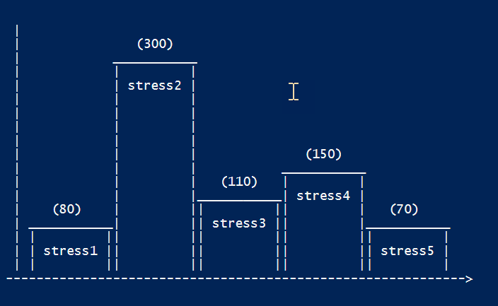
Retro
Just kidding of course ☺
We can do better nowadays
PowerShell Conference
Singapore 2017

Slide 20
.Net Chart Controls
For ASP.Net pages or Windows Forms
PoshCharts by Boe Prox
Number of Out- cmdlets
No COM object
Work in progress
Community contributions welcome
PowerShell Conference
Singapore 2017

Slide 21
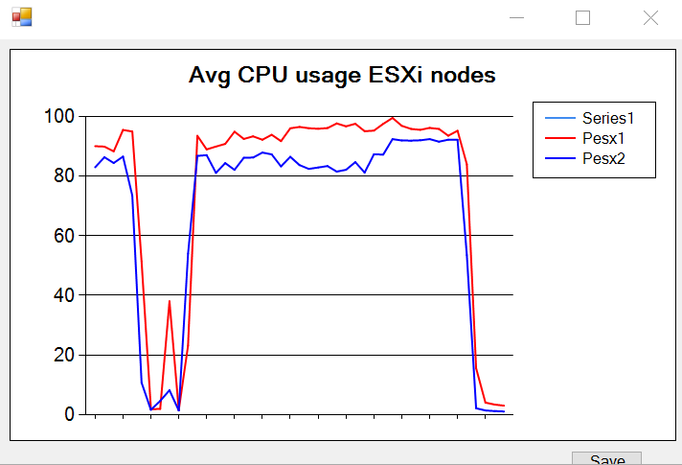
$extract1 = 'D:\Stats\extract1.csv'
$stat = 'cpu.usage.average'
Import-Csv -Path $extract1 -UseCulture |
Where{$_.Entity -match "^esx" -and
$_.MetricId -eq $stat -and
$_.Instance -eq ''} |
Sort-Object -Property Timestamp |
Group-Object -Property Timestamp |
Select Name,
@{N="Pesx1";E={$_.Group | where{$_.Entity -match "esx1"} |
select -ExpandProperty Value}},
@{N="Pesx2";E={$_.Group | where{$_.Entity -match "esx2"} |
select -ExpandProperty Value}} |
Out-LineChart -XField Name -YField1 Pesx1 -YField2 Pesx2 `
-Title 'Avg CPU usage ESXi nodes'
PowerShell Conference
Singapore 2017

Slide 22
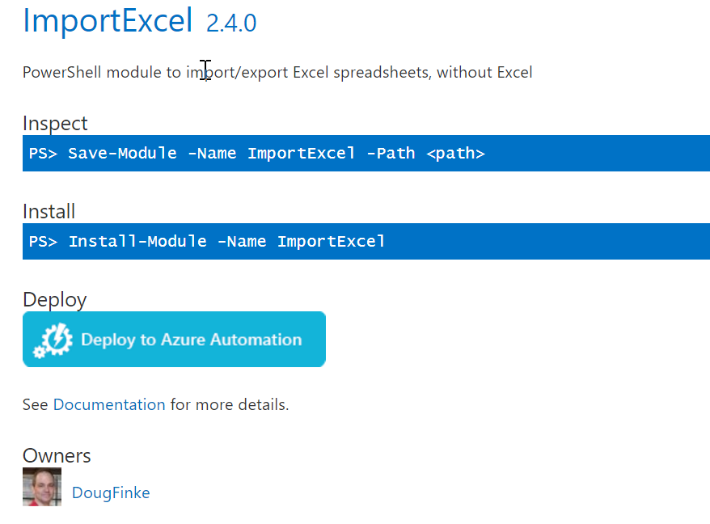
Excel
Doug Finke‘s ImportExcel
Does NOT require Excel to be installed
Don‘t bother with COM objects
Don‘t bother with counting cells
PowerShell Conference
Singapore 2017

Slide 23
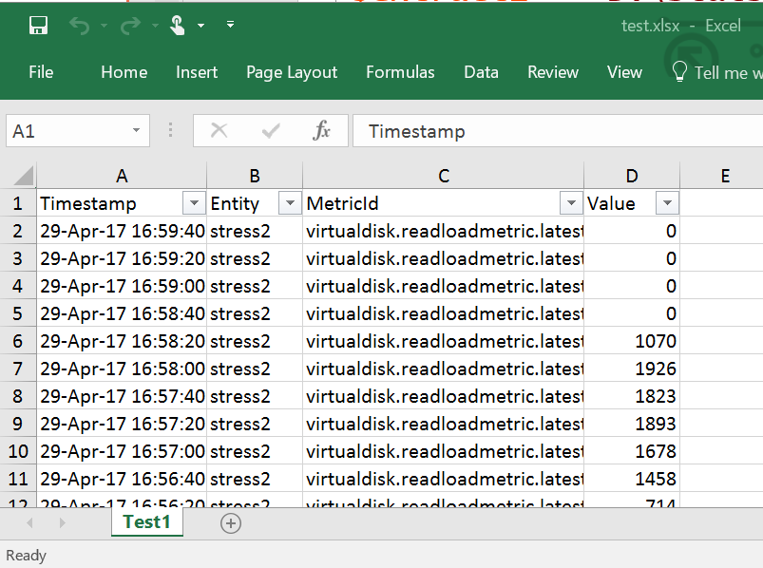
$extract1 = 'D:\Stats\extract1.csv'
$file = 'D:\Stats\test.xlsx'
Import-Csv -Path $extract1 -UseCulture |
Select -First 20 -Property Timestamp,Entity,MetricId,Value |
Export-Excel -Path $file -WorkSheetname Test1 `
-AutoSize -AutoFilter
PowerShell Conference
Singapore 2017

Slide 24
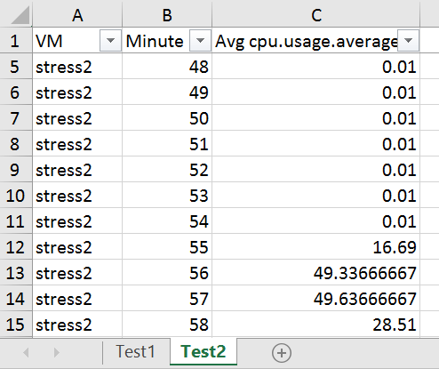
$extract1 = 'D:\Stats\extract1.csv'
$file = 'D:\Stats\test.xlsx'
$vmName = 'stress2'
$stat = 'cpu.usage.average'
Import-Csv -Path $extract1 -UseCulture |
where{$_.Entity -eq $vmName -and $_.MetricId -eq $stat} |
Group-Object -Property {([DateTime]$_.Timestamp).Minute} |
Sort-Object -Property Name |
Select @{N='VM';E={$vmName}},
@{N='Minute';E={$_.Name}},
@{N="Avg $($stat)";
E={$_.Group | Measure-Object -Property Value -Average|
select -ExpandProperty Average}} |
Export-Excel -Path $file -WorkSheetname Test2 `
-AutoSize -AutoFilter -FreezeTopRow
PowerShell Conference
Singapore 2017

Slide 25
Excel
Still no pretty pictures ☹
We‘re getting there
... Just a matter of adding chart parameters
Chart is defined via New-ExcelChart cmdlet
PowerShell Conference
Singapore 2017

Slide 26
$extract1 = 'D:\Stats\extract1.csv'
$file = 'D:\Stats\test2.xlsx'
$vmName = 'stress2'
$stat = 'cpu.usage.average'
$chart = New-ExcelChart -XRange Minute -YRange Avg -ChartType Line
Import-Csv -Path $extract1 -UseCulture |
where{$_.Entity -eq $vmName -and $_.MetricId -eq $stat} |
Group-Object -Property {([DateTime]$_.Timestamp).Minute} |
Sort-Object -Property Name |
Select @{N='VM';E={$vmName}},
@{N='Minute';E={$_.Name}},
@{N="Avg";
E={$_.Group | Measure-Object -Property Value -Average|
select -ExpandProperty Average}} |
Export-Excel -Path $file -WorkSheetname Test3 `
-ExcelChartDefinition $chart -AutoNameRange `
-AutoSize -AutoFilter -FreezeTopRow
PowerShell Conference
Singapore 2017

Slide 27
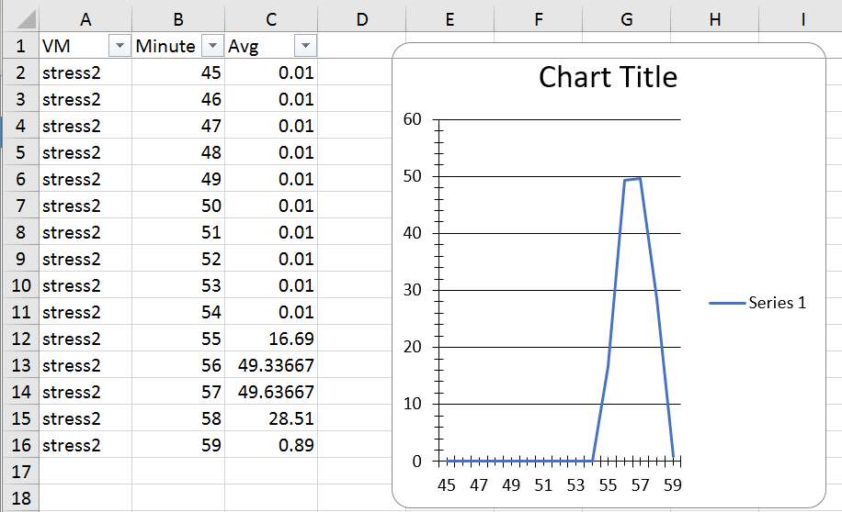
PowerShell Conference
Singapore 2017

Slide 28
$sChart = @{
XRange = 'Minute'
YRange = 'Avg'
Title = "Avg CPU usage $($vmName)"
ChartType = 'Area3D'
SeriesHeader = "$($vmName)"
}
$chart = New-ExcelChart @sChart
Import-Csv -Path $extract1 -UseCulture |
where{$_.Entity -eq $vmName -and $_.MetricId -eq $stat} |
Group-Object -Property {([DateTime]$_.Timestamp).Minute} |
Sort-Object -Property Name |
Select @{N='VM';E={$vmName}},
@{N='Minute';E={$_.Name}},
@{N="Avg";
E={$_.Group | Measure-Object -Property Value -Average|
select -ExpandProperty Average}} |
Export-Excel -Path $file -WorkSheetname Test5 `
-ExcelChartDefinition $chart -AutoNameRange `
-AutoSize -AutoFilter -FreezeTopRow -Show
PowerShell Conference
Singapore 2017

Slide 29
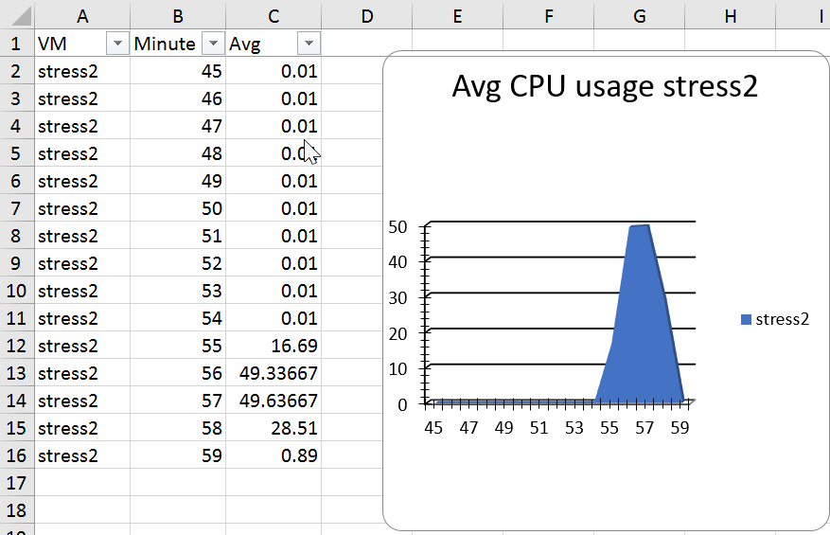
PowerShell Conference
Singapore 2017

Slide 30
$extract1 = 'D:\Stats\extract1.csv'
$file = 'D:\Stats\test2.xlsx'
$vmName = "^stress"
$stat = 'cpu.usage.average'
$sChart = @{
XRange = 'Minute'
YRange = 'stress1','stress2','stress3','stress4','stress5'
Title = "Avg CPU usage"
ChartType = 'Line'
}
$chart = New-ExcelChart @sChart
Import-Csv -Path $extract1 -UseCulture |
where{$_.Entity -match $vmName -and $_.MetricId -eq $stat} |
Group-Object -Property {([DateTime]$_.Timestamp).Minute} |
Sort-Object -Property Name | %{
$obj = [ordered]@{
Minute = $_.Name
}
$_.Group | Group-Object -Property Entity |
Sort-Object -Property Name | %{
$avg = $_.Group |Measure-Object -Property Value -Average |
Select -ExpandProperty Average
$obj.Add($_.Name,$avg)
}
New-Object PSObject -Property $obj
} |
Export-Excel -Path $file -WorkSheetname Test6 `
-ExcelChartDefinition $chart -AutoNameRange `
-AutoSize -AutoFilter -FreezeTopRow -Show
PowerShell Conference
Singapore 2017

Slide 31
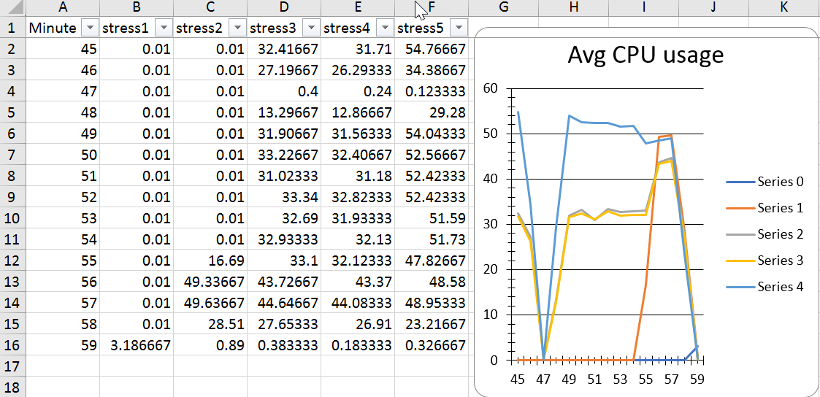
PowerShell Conference
Singapore 2017

Slide 32
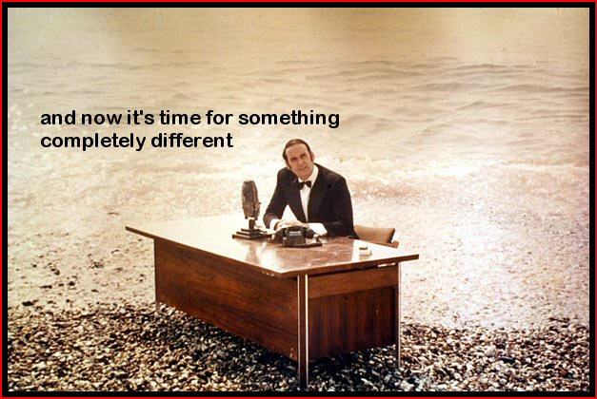
PowerShell Conference
Singapore 2017

Slide 33
Containers
Growing up
Increasing number of containers available
Take away the tedious overhead
Just concentrate on the app(s)
… and how they (can) interact
PowerShell Conference
Singapore 2017

Slide 34
Ad-hoc Perf
Most solutions will do
But… remote, sharing, ad-hoc
Containerised solution
To explore the possibilities ☺
Got hooked, wrote some functions
Photon as host
PowerShell/PowerCLI Core to automate
InfluxDB for data
Grafana for graphical interface
PowerShell Conference
Singapore 2017

Slide 35
Principles of Operation
Problem reported, SBY called
Fire up the VM, deploy the containers
vSphere extraction scripts run in PowerCLI Core
Parameterised
Flushes data to InfluxDB
Grafana row templates
Create dashboard, optionally add rows
Access via http(s)
PowerShell Conference
Singapore 2017

Slide 36
# Statistical data to InfluxDB
$dbName = 'vsphere'
$table = 'stats'
Remove-InfluxDB -DBName $dbName
New-InfluxDB -DBName $dbName
$start = [DateTime]"2017-09-29 16:45:00"
$finish = [DateTime]"2017-09-29 17:00:00"
$sFLux = @{
DBName = $dbName
Measurement = $table
Start = $start
Finish = $finish
}
Import-InfluxDB @sFlux
PowerShell Conference
Singapore 2017

Slide 37
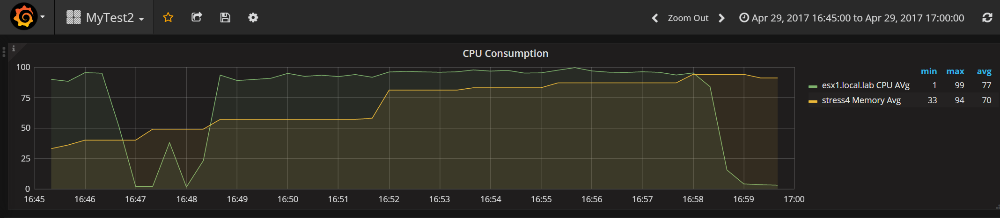
# Create Grafana dashboard from template
$sGraf = @{
Name = 'MyTest2'
Template = 'D:\Stats\MyDashBoard1.xml'
}
New-GrafanaDashBoard @sGraf
PowerShell Conference
Singapore 2017

Slide 38
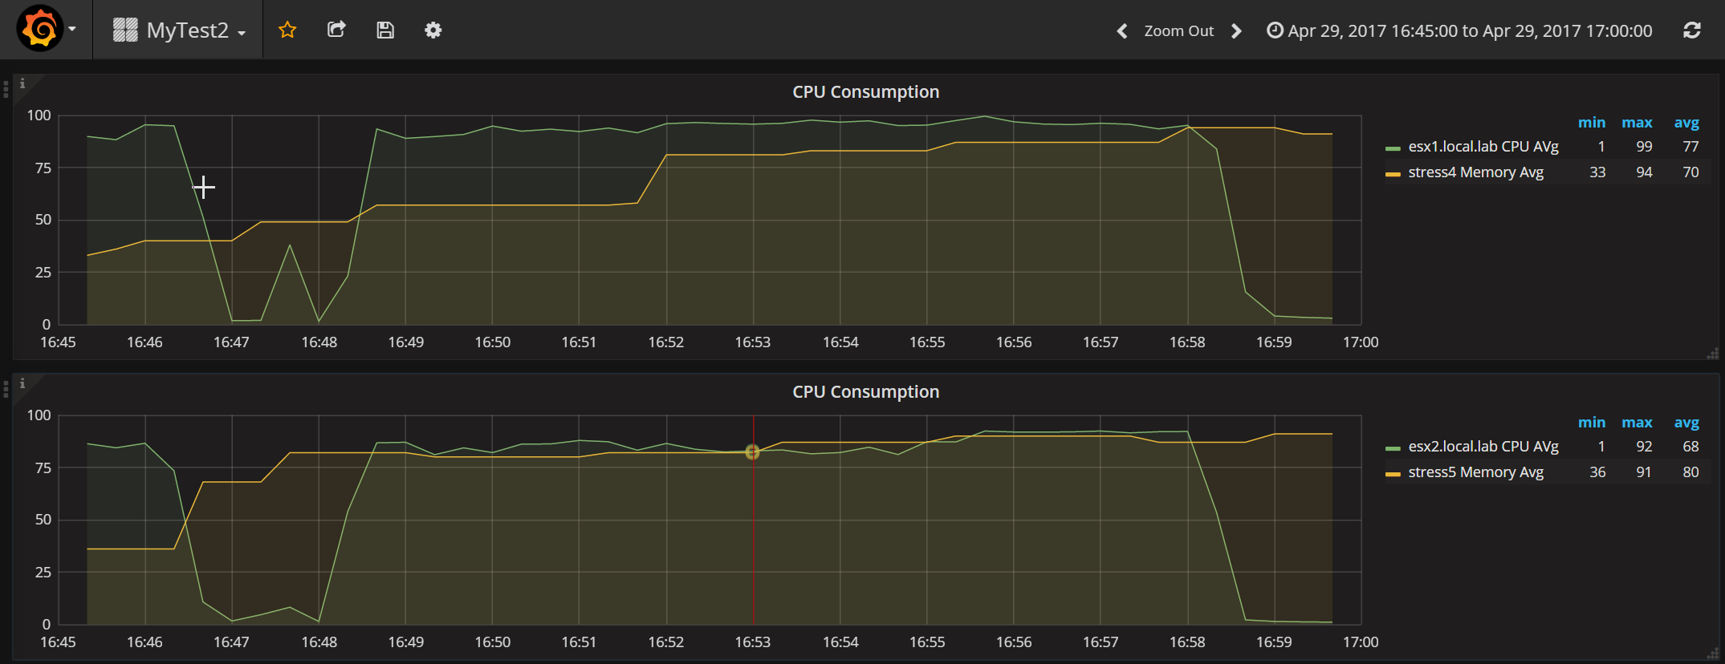
# Add a row on dashboard
$sGraf = @{
Dashboard = 'MyTest2'
Template = 'D:\Stats\MyDashBoard1.xml'
EsxName = 'esx2.local.lab'
VMName = 'stress5'
}
New-GrafanaDBRow @sGraf
PowerShell Conference
Singapore 2017

Slide 39
Next <Container> Steps…
Module?
Templates
Export
From scratch
Triggers
vSphere Alarms
SNMP trap
Slack robot
PowerShell Conference
Singapore 2017

Slide 40
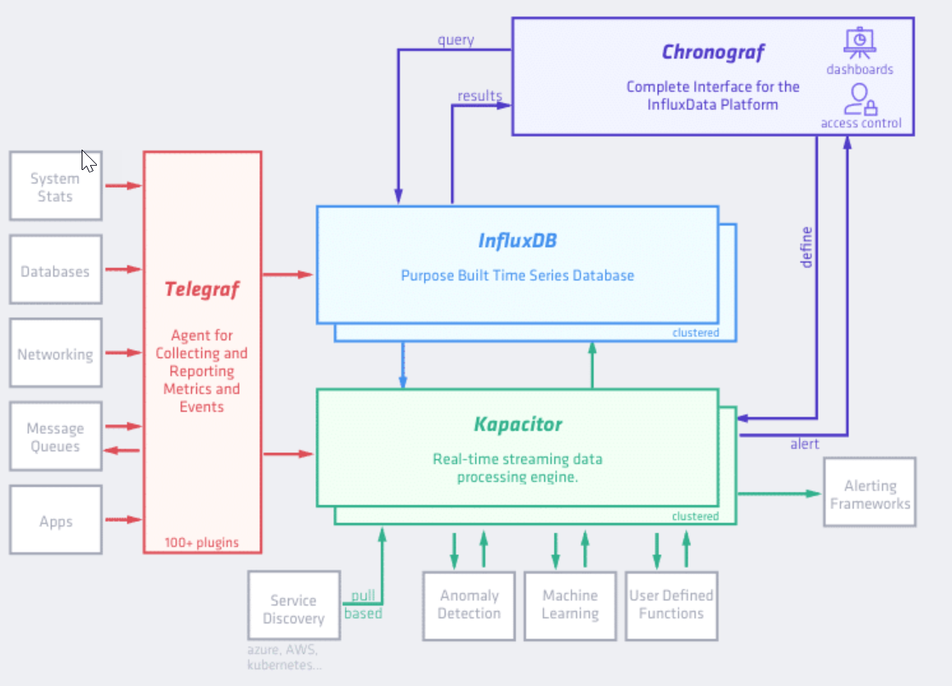
Until I discovered TICK
InfluxDB
The DB
Telegraf
Capture Data
Chronograf
Display
Kapacitor
Alerting
PowerShell Conference
Singapore 2017

Slide 41
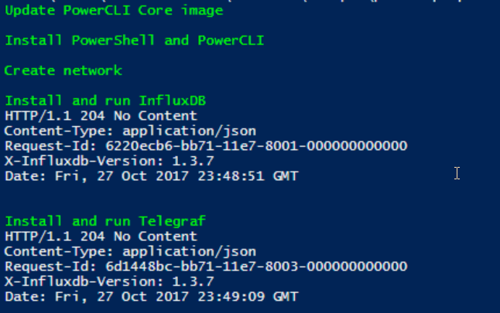
Use the Containers
# Install & start InfluxDB
$fluxRun = @"
docker run -d -it --name influxdb -p 8086:8086 -v /db:/var/lib/influxdb --network tics-net influxdb &> /dev/null
sleep 10
curl -I http://localhost:8086/ping
"@
Write-Host -ForegroundColor Green "Install and run InfluxDB"
$sInvoke.ScriptText = $fluxRun
Invoke-VMScriptPlus @sInvoke | select -ExpandProperty ScriptOutput
PowerShell Conference
Singapore 2017

Slide 42
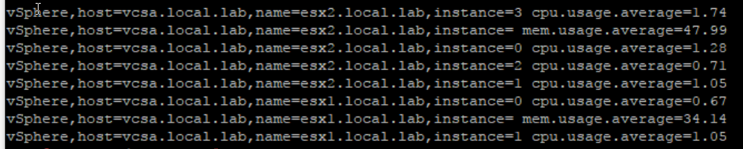
Only code what is specific
$pcliRun = @"
mkdir -p /scripts
cat > /scripts/collect-esx.ps1 << EOF
Set-PowerCLIConfiguration -InvalidCertificateAction Ignore -DisplayDeprecationWarnings:\`$false -Scope AllUsers -Confirm:\`$false | Out-Null
Connect-VIServer -Server $($vcName) -User '$($vcUser)' -Password '$($pswd)' | Out-Null
\`$clusterName = 'Cluster1'
\`$stat = 'cpu.usage.average','mem.usage.average'
\`$esx = Get-Cluster -Name \`$clusterName | Get-VMHost
Get-Stat -Entity \`$esx -Stat \`$stat -Realtime -MaxSamples 1 |
where{\`$_.MetricId -notmatch "^cpu" -or \`$_.Instance -ne ''} | %{
"vSphere,host={0},name={1},instance={2} {3}={4}" -f \`$global:DefaultVIServer.Name,\`$_.Entity.Name,\`$_.Instance,\`$_.MetricId,\`$_.Value
}
Disconnect-VIServer -Server $($vcName) -Confirm:\`$false
EOF
"@
$sInvoke = @{
VM = $vm
ScriptType = 'Bash'
ScriptText = $pcliRun
GuestUser = $user
GuestPassword = $pswd
}
Write-Host -ForegroundColor Green "Install PowerShell and PowerCLI"
Invoke-VMScriptPlus @sInvoke | select -ExpandProperty ScriptOutput
PowerShell Conference
Singapore 2017

Slide 43
Expand your horizon
[[inputs.system]]
[[inputs.exec]]
commands = ["docker run --rm -it --entrypoint=powershell -v /scripts/:/tmp/scripts powerclicore:ld /tmp/scripts/collect-esx.ps1"]
timeout = "10s"
data_format = "influx"
EOF
docker run -it -d --network tics-net \
--name telegraf --hostname $($vmName) \
-v /sys:/rootfs/sys:ro \
-v /proc:/rootfs/proc:ro \
-v /var/run/docker.sock:/var/run/docker.sock:ro \
-v /var/run/utmp:/var/run/utmp:ro \
-v `${HOME}/telegraf.conf:/etc/telegraf/telegraf.conf:ro \
telegraf &> /dev/null
sleep 10
curl -I http://localhost:8086/ping
curl -G 'http://localhost:8086/query?pretty=true' --data-urlencode "q=SHOW DATABASES"
"@
Write-Host -ForegroundColor Green "Install and run Telegraf"
$sInvoke.ScriptText = $grafRun
Invoke-VMScriptPlus @sInvoke | select -ExpandProperty ScriptOutput
PowerShell Conference
Singapore 2017

Slide 44
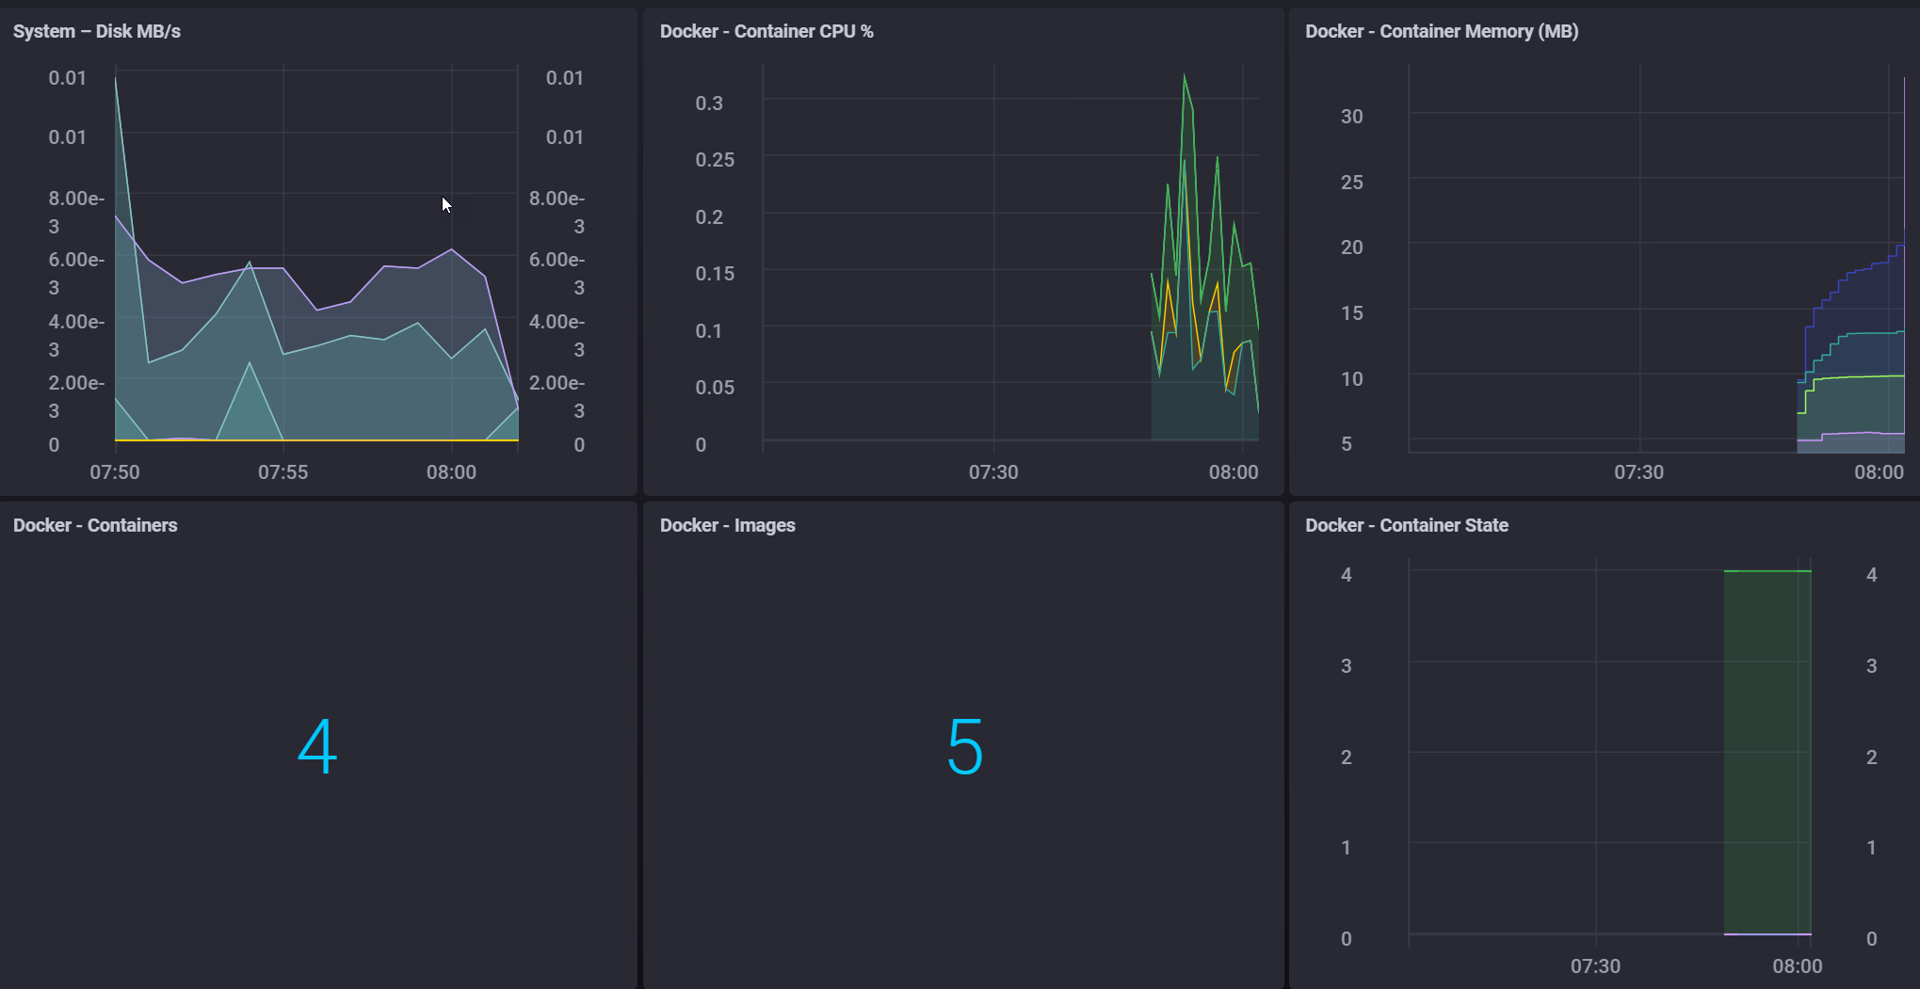
And get results
PowerShell Conference
Singapore 2017

Slide 45
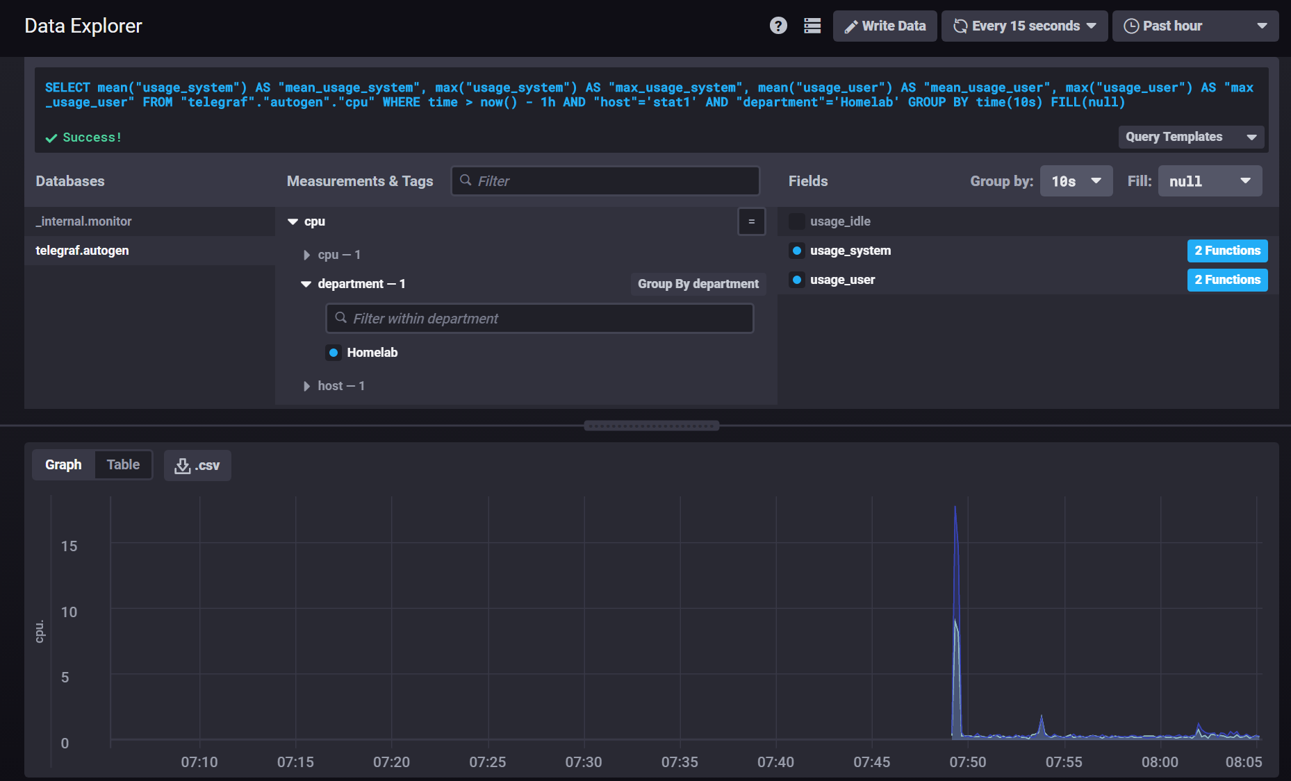
Out of the box
PowerShell Conference
Singapore 2017

Slide 46
Key Takeaways
PowerShell is your tool of choice
But expand (bash, curl, REST API…)
Containers are Great/Fun
Don’t reinvent, use what is there
PowerShell Conference
Singapore 2017

Slide 47

Q&A
PowerShell Conference
Singapore 2017

Slide 48
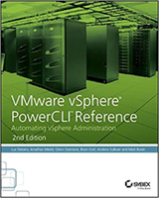


About_Author
Luc Dekens
Belgium (the Flemish part)
Virtualisation ➔ PowerShell/PowerCLI ➔ SDDC ➔ DSC
PowerCLI Reference 1 ed & 2 ed
VMTN Community LucD
Blog LucD.info
Twitter @LucD22
PowerShell Conference
Singapore 2017

Slide 49
Don’t Forget!
Fill in your survey in Mobile app – it’s how we do better!
Don’t lose you badge! You need it for the Social Events
Grab the Speakers for a chat – they all have time for you!
Let everyone know what they are missing on Social Media
#PowerShell
#PSConfAsia
Photos of Marina Bay Credit: Sebastian Szumigalski
PowerShell Conference
Singapore 2017

